Slide 1
Naïve Bayes Classifier
Prepared By-
Mrs. Jheelam Mondal
Assistant Professor, CSE Department

Slide 2
Naïve Bayes Classifier Algorithm
Naïve Bayes algorithm is a supervised learning algorithm, which is based on Bayes theorem and used for solving classification problems.
It is mainly used in text classification that includes a high-dimensional training dataset.
Naïve Bayes Classifier is one of the simple and most effective Classification algorithms which helps in building the fast machine learning models that can make quick predictions.
It is a probabilistic classifier, which means it predicts on the basis of the probability of an object.

Slide 3
Why Naive Bayes?
The Naïve Bayes algorithm is comprised of two words Naïve and Bayes, Which can be described as:
Naïve: It is called Naïve because it assumes that the occurrence of a certain feature is independent of the occurrence of other features.
Bayes: It is called Bayes because it depends on the principle of Bayes' Theorem.
Some popular examples of Naïve Bayes Algorithm are spam filtration, Sentimental analysis, and classifying articles.

Slide 4

Bayes Theorem
Bayes' theorem is also known as Bayes' Rule or Bayes' law, which is used to determine the probability of a hypothesis with prior knowledge. It depends on the conditional probability.
The formula for Bayes' theorem is given as:
Where A and B are events and P(B) ≠ 0

Slide 5
Bayes Theorem contd..
Where
P(A|B) is Posterior probability: Probability of hypothesis A after event B(evidence) is observed.
P(B|A) is Likelihood probability: Probability of the evidence given that the probability of a hypothesis is true.
P(A) is Prior Probability: Probability of hypothesis before observing the evidence.
P(B) is Marginal Probability: Probability of Evidence.

Slide 6
Steps of Naïve Bayes' Classifier:
So to solve this problem, we need to follow the below steps:
1.Convert the given dataset into frequency tables.
2. Generate Likelihood table by finding the probabilities of given features.
3. Now, use Bayes theorem to calculate the posterior probability.

Slide 7
Working of Naïve Bayes' Classifier:
Suppose we have a dataset of weather conditions and corresponding target variable "Play". So using this dataset we need to decide that whether we should play or not on a particular day according to the weather conditions.
Problem: If the weather is sunny, then the Player should play or not?
Solution: To solve this, first consider the below dataset:

Slide 8
 | Outlook | Play
0 | Rainy | Yes
1 | Sunny | Yes
2 | Overcast | Yes
3 | Overcast | Yes
4 | Sunny | No
5 | Rainy | Yes
6 | Sunny | Yes
7 | Overcast | Yes
8 | Rainy | No
9 | Sunny | No
10 | Sunny | Yes
11 | Rainy | No
12 | Overcast | Yes
13 | Overcast | Yes
Solution: To solve this, first consider the dataset:

Slide 9
Frequency Distribution for the Weather Conditions:
Weather | Yes | No
Overcast | 5 | 0
Rainy | 2 | 2
Sunny | 3 | 2
Total | 10 | 4

Slide 10
Likelihood table
Weather | No | Yes
Overcast | 0 | 5 | 5/14= 0.35
Rainy | 2 | 2 | 4/14=0.29
Sunny | 2 | 3 | 5/14=0.35
All | 4/14=0.29 | 10/14=0.71

Slide 11
Applying Bayes’ theorem:
P(Yes|Sunny)= P(Sunny|Yes)*P(Yes)/P(Sunny)
P(Sunny|Yes)= 3/10= 0.3
P(Sunny)= 0.35
P(Yes)=0.71
So P(Yes|Sunny) = 0.3*0.71/0.35= 0.60
P(No|Sunny)= P(Sunny|No)*P(No)/P(Sunny)
P(Sunny|NO)= 2/4=0.5
P(No)= 0.29
P(Sunny)= 0.35
So P(No|Sunny)= 0.5*0.29/0.35 = 0.41
So as we can see from the above calculation that P(Yes|Sunny)>P(No|Sunny)
Hence on a Sunny day, Player can play the game.

Slide 12
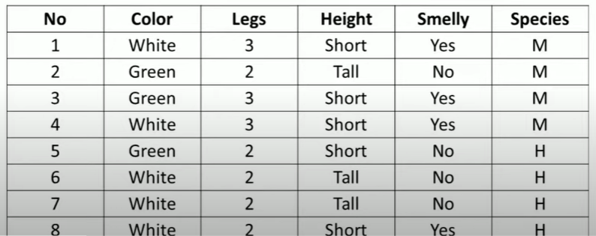
Q2) Naïve Bayes dataset - Numerical

Slide 13
Species Classes (Target) – {M,H} Attributes – (Color, legs, Height, Smelly)
Test Instance
(Color=Green, legs=2, Height=Tall, Smelly=No)
Prior probabilities are as follows -
P(M) = 4/8 = 0.5
P(H) = 4/8 = 0.5

Slide 14
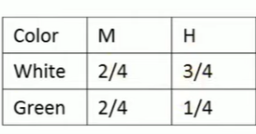
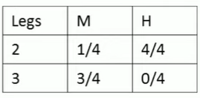
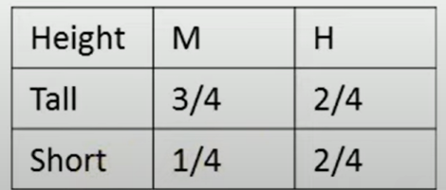
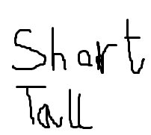
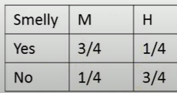
Find conditional probabilities for all attributes

Slide 15
P(M| New instance) = P(Color=Green|M) * P(Legs=2|M) * P(Height=tall|M) * P(Smelly=No|M) * P(M)
= 2/4*1/4*1/4*1/4*0.5 = 0.0039 = 0.004 (approx.)
P(H| New Instance) = P(Color=Green|H) * P(Legs=2|H) * P(Height=tall|H) * P(Smelly=No|H) * P(H)
= 1/4*4/4*2/4*3/4*0.5 = 0.0468 = 0.047 (approx.)
P(H|New Instance) > P(M|New Instance) , so the new species belongs to class H.

Slide 16
Advantages of Naïve Bayes Classifier:
Naïve Bayes is one of the fast and easy ML algorithms to predict a class of datasets.
It can be used for Binary as well as Multi-class Classifications.
It performs well in Multi-class predictions as compared to the other Algorithms.
It is the most popular choice for text classification problems.

Slide 17
Disadvantages of Naïve Bayes Classifier:
Naive Bayes assumes that all features are independent or unrelated, so it cannot learn the relationship between features.
If test data set has a categorical variable of a category that wasn’t present in training data then this model will assign it zero probability and will not be able to make any predictions.

Slide 18
Measuring classifier accuracy – Revision topic
Confusion matrix
It is one of the simplest metrics used for finding the accuracy of any classification model for a given set of test data. Suppose we want to make a prediction whether a person will buy a computer or not based on some input parameters. Two target variables are assigned – buys_computer is 1 and does_not_buy_computer as 0. When we built the model we set aside some tuples as testing tuples. That test data has an actual output. Again we can predict the output based on the model also. So this confusion matrix is the matrix between this actual and predicted values.

Slide 19
Predicted values are those values, which are predicted by the model, and actual values are the true values for the given observations.
It looks like the below table:
True Positive: The model has predicted Yes, and the actual value was also true.
False Positive: The model has predicted Yes, but the actual value was No. It is also called a Type-I error.
True Negative: Model has given prediction No, and the real or actual value was also No.
False Negative: The model has predicted No, but the actual value was Yes, it is also called as Type-II error.
n = total predictions | POSITIVE(Actual = yes) | NEGATIVE(Actual = no)
POSITIVE(Predicted = yes) | TP | FP
NEGATIVE(Predicted =no) | FN | TN

Slide 20
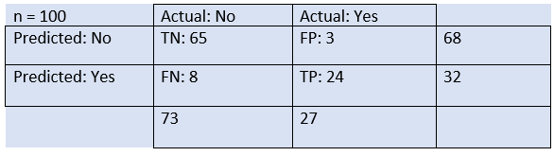
35.4M
693
HTML Tutorial
Suppose we want are creating a model that predicts
whether a person has the disease or not.
From the above example, we can conclude that:
The table is given for the two-class classifier, which has two predictions "Yes" and "NO." Here, Yes defines that patient has the disease, and No defines that patient does not has that disease.
The classifier has made a total of 100 predictions. Out of 100 predictions, 89 are true predictions, and 11 are incorrect predictions.
The model has given prediction "yes" for 32 times, and "No" for 68 times. Whereas the actual "Yes" was 27, and actual "No" was 73 times.

Slide 21
Classification Accuracy:
It is one of the important parameters to determine the accuracy of the classification problems. It defines how often the model predicts the correct output. It can be calculated as the ratio of the number of correct predictions made by the classifier to all number of predictions made by the classifiers. The formula is given below:
Accuracy = (TP + TN)/(TP+FN+FP+TN)
It is evident that accuracy nears 100% if FN and FP are lesser.

Slide 22
Misclassification rate/ Classification error
It tells you what fraction of predictions were incorrect.
It is calculated using (FP+FN)/(TP+TN+FP+FN)
Or (1 – Accuracy)
So misclassification rate is basically the summation of Type-I and Type-II errors by the total.

Slide 23
Precision: It can be defined as the number of correct outputs provided by the model or out of all positive classes that have predicted correctly by the model, how many of them were actually true. It can be calculated using the below formula:
Precision = TP/(TP+FP)
Recall or Sensitivity : It is defined as the out of total positive classes, how our model predicted correctly. The recall must be as high as possible.
Sensitivity = TP/(TP+FN)

Slide 24
Specificity : It tells us what proportion of output classes which is false were predicted to be false. Example, in case of classifying skin cancer patients as malignant or benign, specificity is the measure of patients who did not have cancer (benign) were predicted by the model as non-cancerous (benign).
Specificity = TN/(TN+FP)
F-score : If two models have low precision and high recall or vice versa, it is difficult to compare these models. So, for this purpose, we can use F-score. This score helps us to evaluate the recall and precision at the same time. The F-score is maximum if the recall is equal to the precision. It can be calculated using the below formula:
F-Score = (2 * Precision * Recall)/(Precision + Recall)

Slide 25
Thank You

